Slide 1

ANALYTICAL REPORT
“AIRBNB”

Slide 2
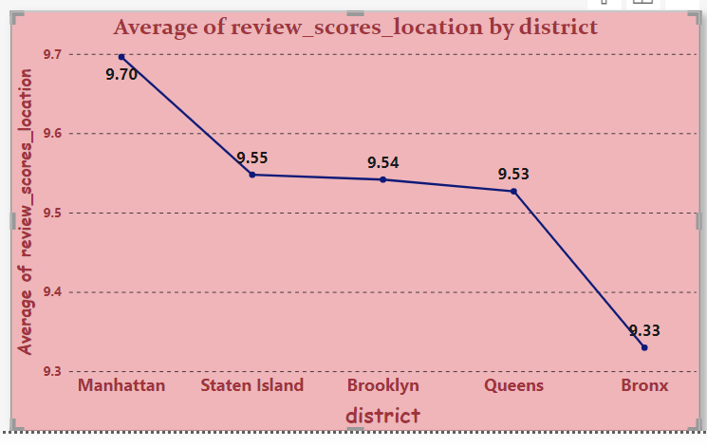
As per the Data Bronx is the least favorable location

Slide 3
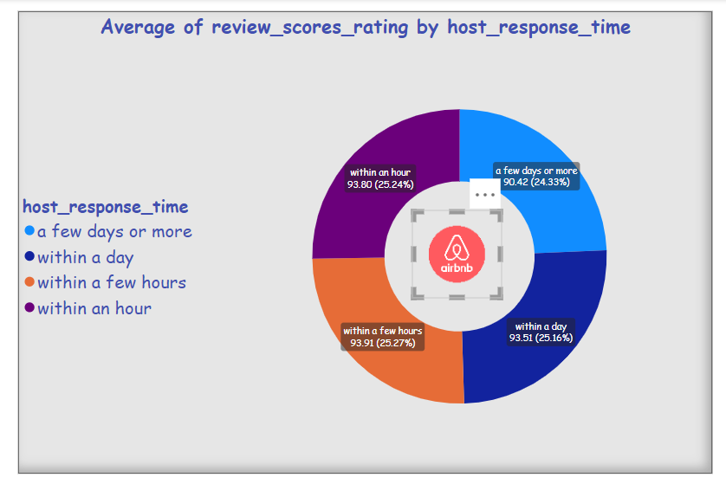

Slide 4
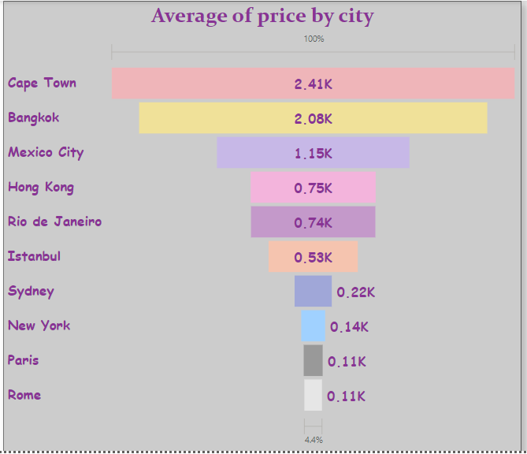
This presentation gives an average listing prices trends across different cities

Slide 5
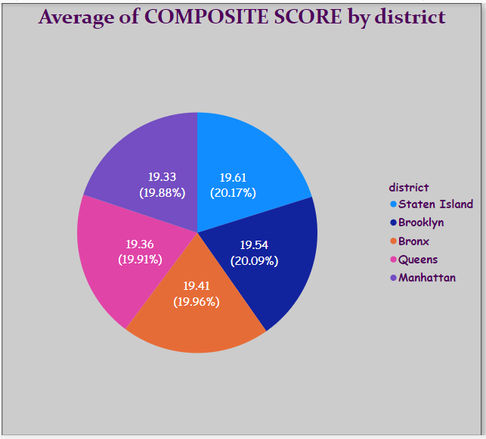
This slides represents the district wise composite scores on the basis of host communication or ratings

Slide 6
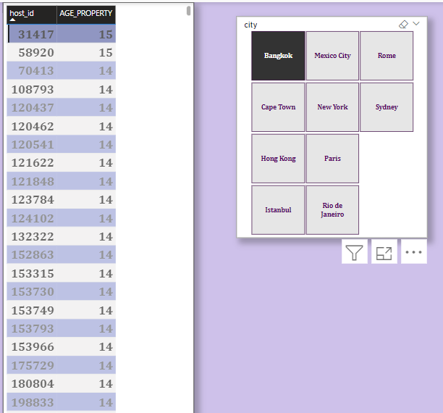
This slides represents the age of Airbnb listings according to cities which are more than 10 years of hosting expertise

Slide 7
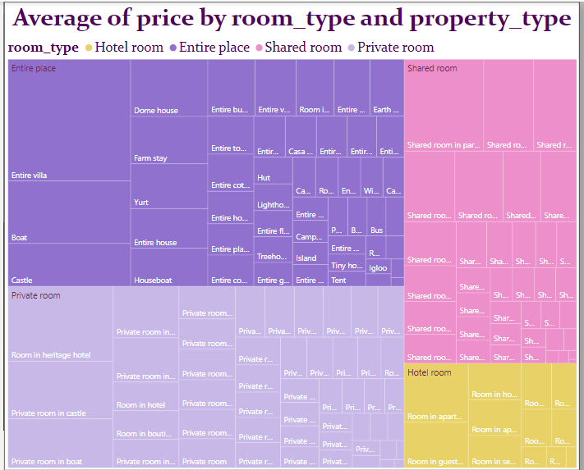
This slides represents the different types of properties , rooms with their price

Slide 8
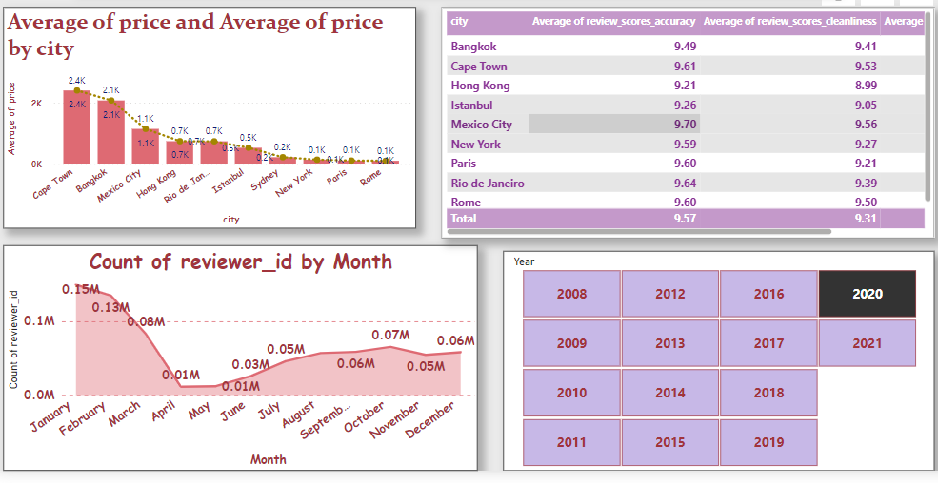
Insight City Comprehensive Report

